Slide 1
Mediation of Glycemia Exposure in on Time-to-Retinopathy in Type 2 Diabetes
Brendon Chau

Slide 2
Table of contents
Preliminary EWAS Results
Functional Annotation
Mediation Model

Slide 3
Study Objectives
Identify differentially methylated CpG sites associated with glycemia exposures
Identify differentially methylated CpG sites associated with diabetic complications
  retinopathy
  nephropathy
Determine whether the identified CpG sites are responsible for the association between glycemia exposures and DM complications

Slide 4
Cohort Identification
Subjects must have
  $≥1$ DM Dx code or equivalent in pre-period to be included
  $≥3$ HbA1c measurements in at least two distinct years, in the 5 years prior to blood sample collection
In MVP, currently have a sample of 12,037 T2D subjects with methylation data and meet the inclusion criteria

Slide 5
Outcome Definition
Use available patient level EHR data to identify Type 2 diabetic subjects
  Diagnosis codes alone may fail to capture subjects diagnosed outside of the VA
Diabetic Retinopathy identified by algorithm defined in (Breeyear et al. 2023):

Slide 6
Epigenome-Wide Association Study
Hypothesis: High HbA1c has a cumulative effect on DNA methylation levels
EWAS covariate of interest: historical HbA1c level 5 years prior to DNA methylation sample collection:
EWAS covariates for adjustment (base model): sex, age, cell composition, genetic principal components, potential batch effects, duration of diabetes¹(Yang et al. 2024) prior to MVP blood sample collection
  Duration of diabetes is left-censored, additional analyses were conducted with patients newly diagnosed with T2D within the VA system, with similar findings.
$$\begin{matrix}M & ∼\text{HbA1c Exposure + sex + age + HARE ancestry} \\ & +\text{ Time since Diabetes Dx (years) + cell composition + batch effects}\end{matrix}$$
where $M=\log_{2}\left(\frac{β}{1−β}\right)$.

Slide 7
Exposure Definitions
Figure 1: Hypothetical HbA1C trajectory in pre-period, where sample collection occurs nine years following initial DM diagnosis

Slide 8
All exposures are defined using HbA1c measurements collected from five years prior up to and including the MVP sample collection date
Mean HbA1c level
Excess HbA1c level
  Threshold set at 6.1% HbA1c (see Miller and Orchard (2020))
CV of HbA1c level
HbA1c measurements below 4% and above 18% were excluded

Slide 9
Preliminary EWAS Results

Slide 10
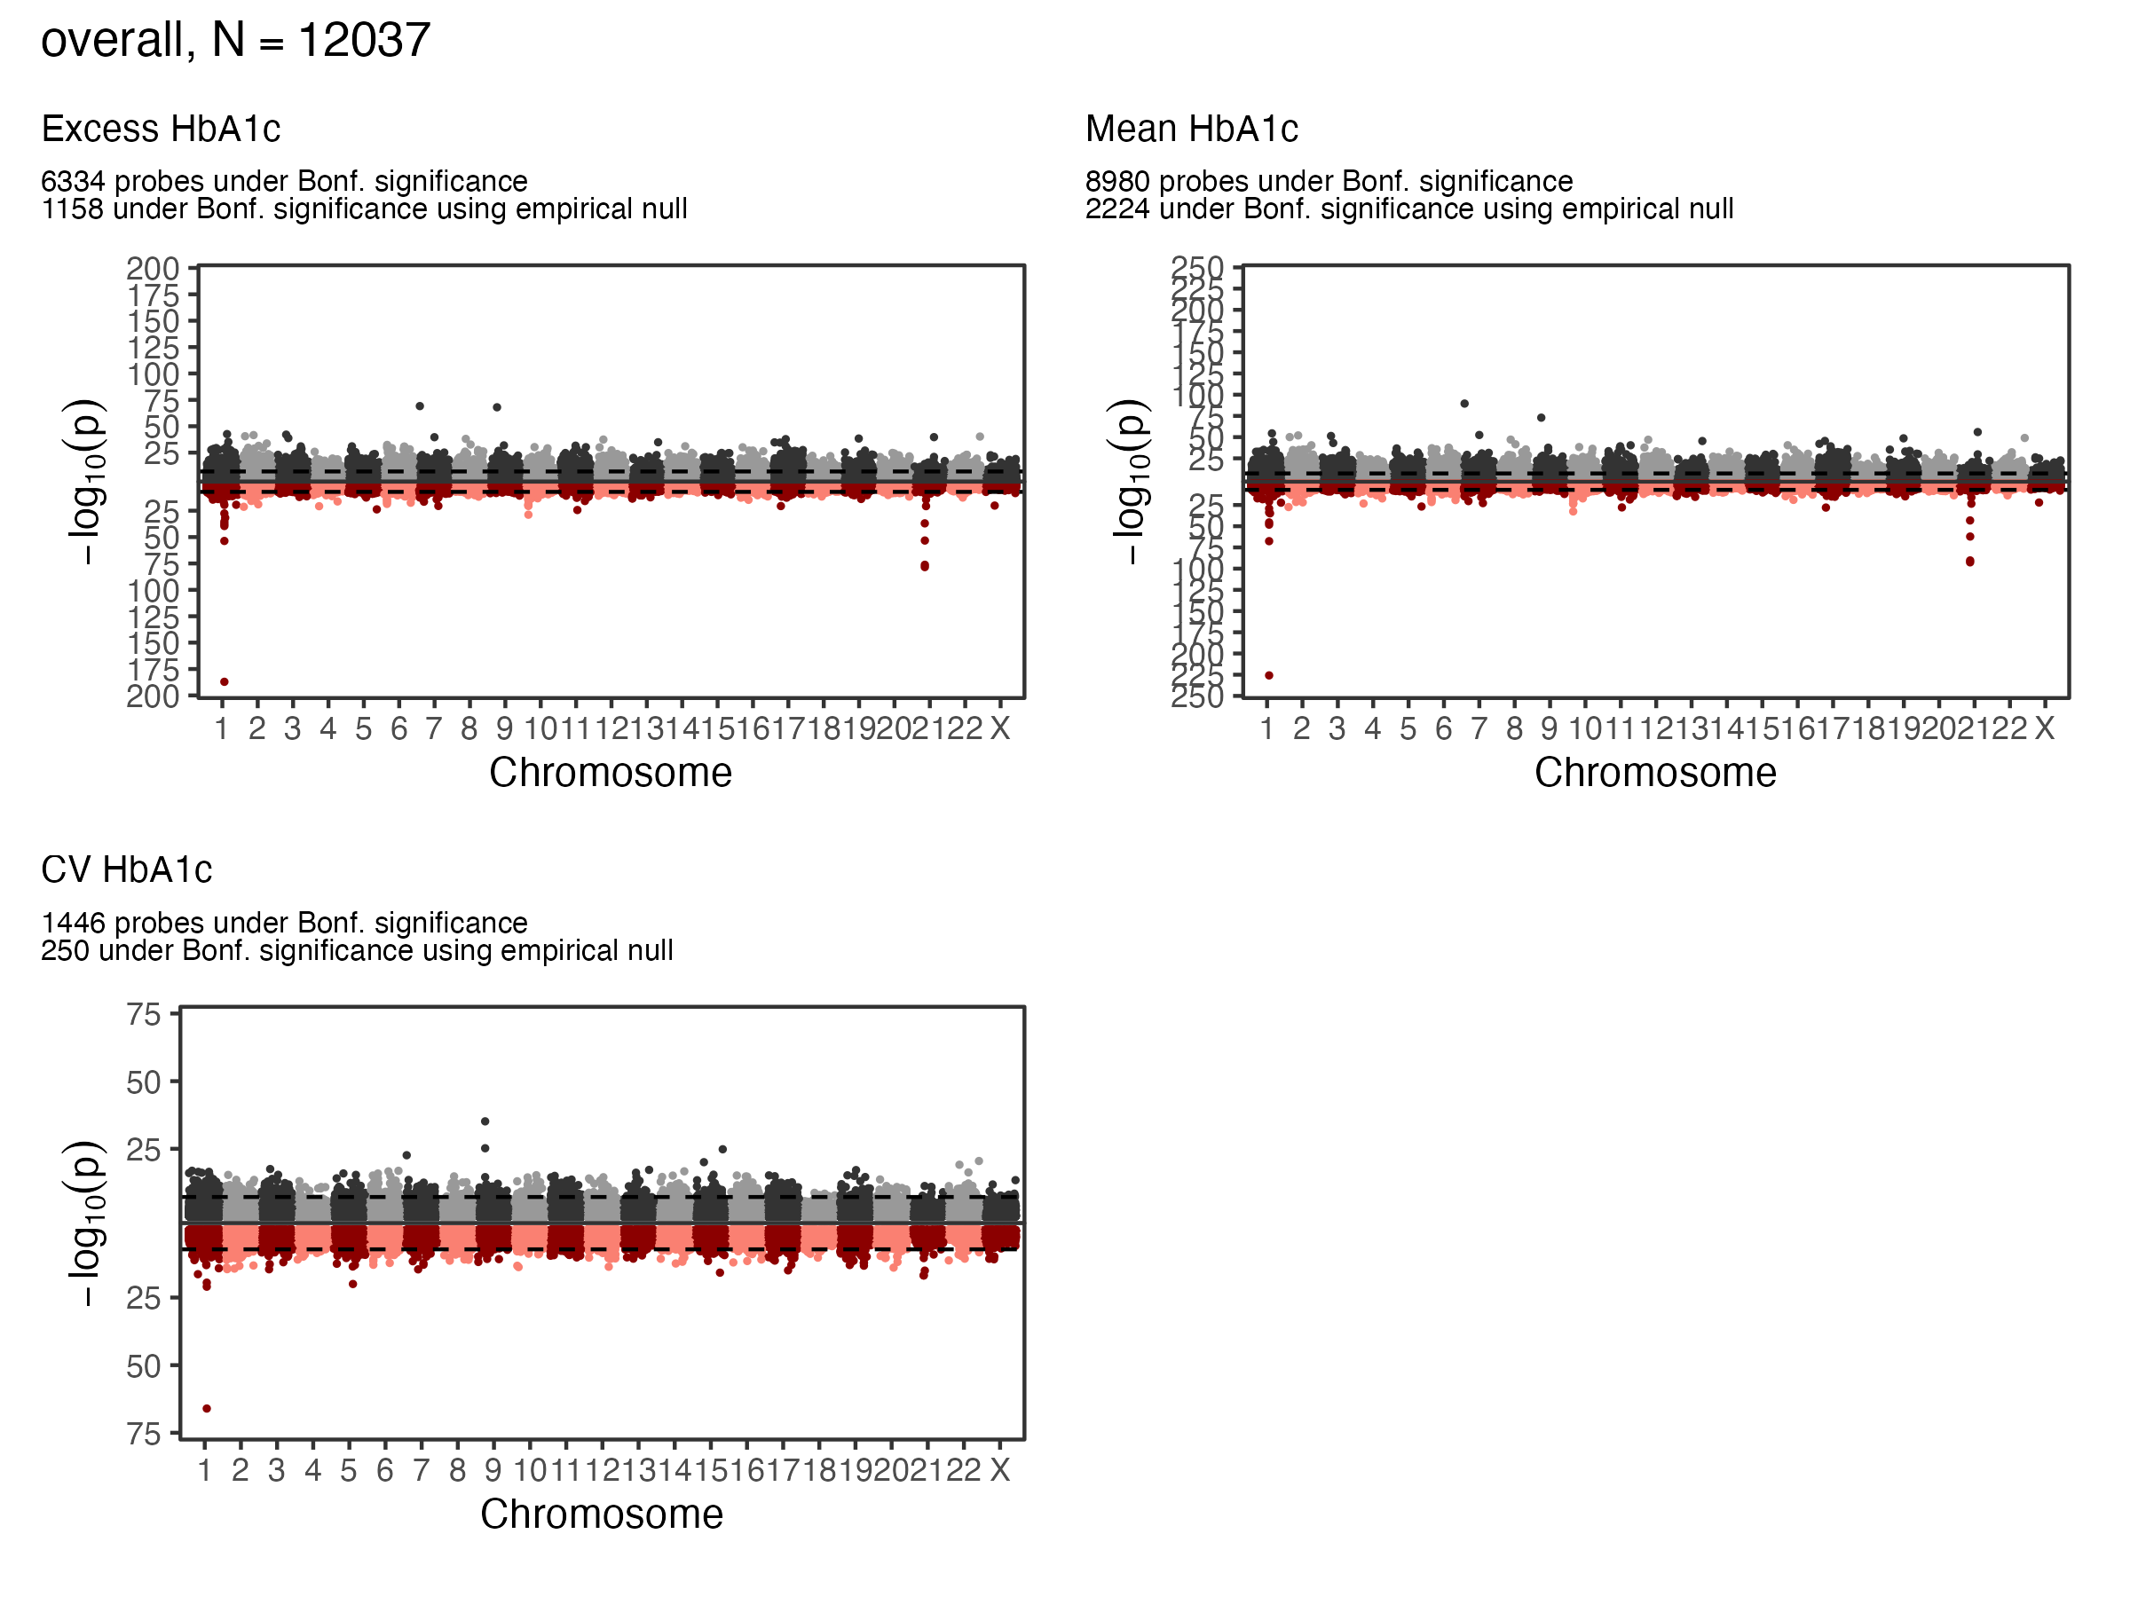
EWAS Results - A1c - Overall
Overall Sample EWAS Manhattan Plot

Slide 11
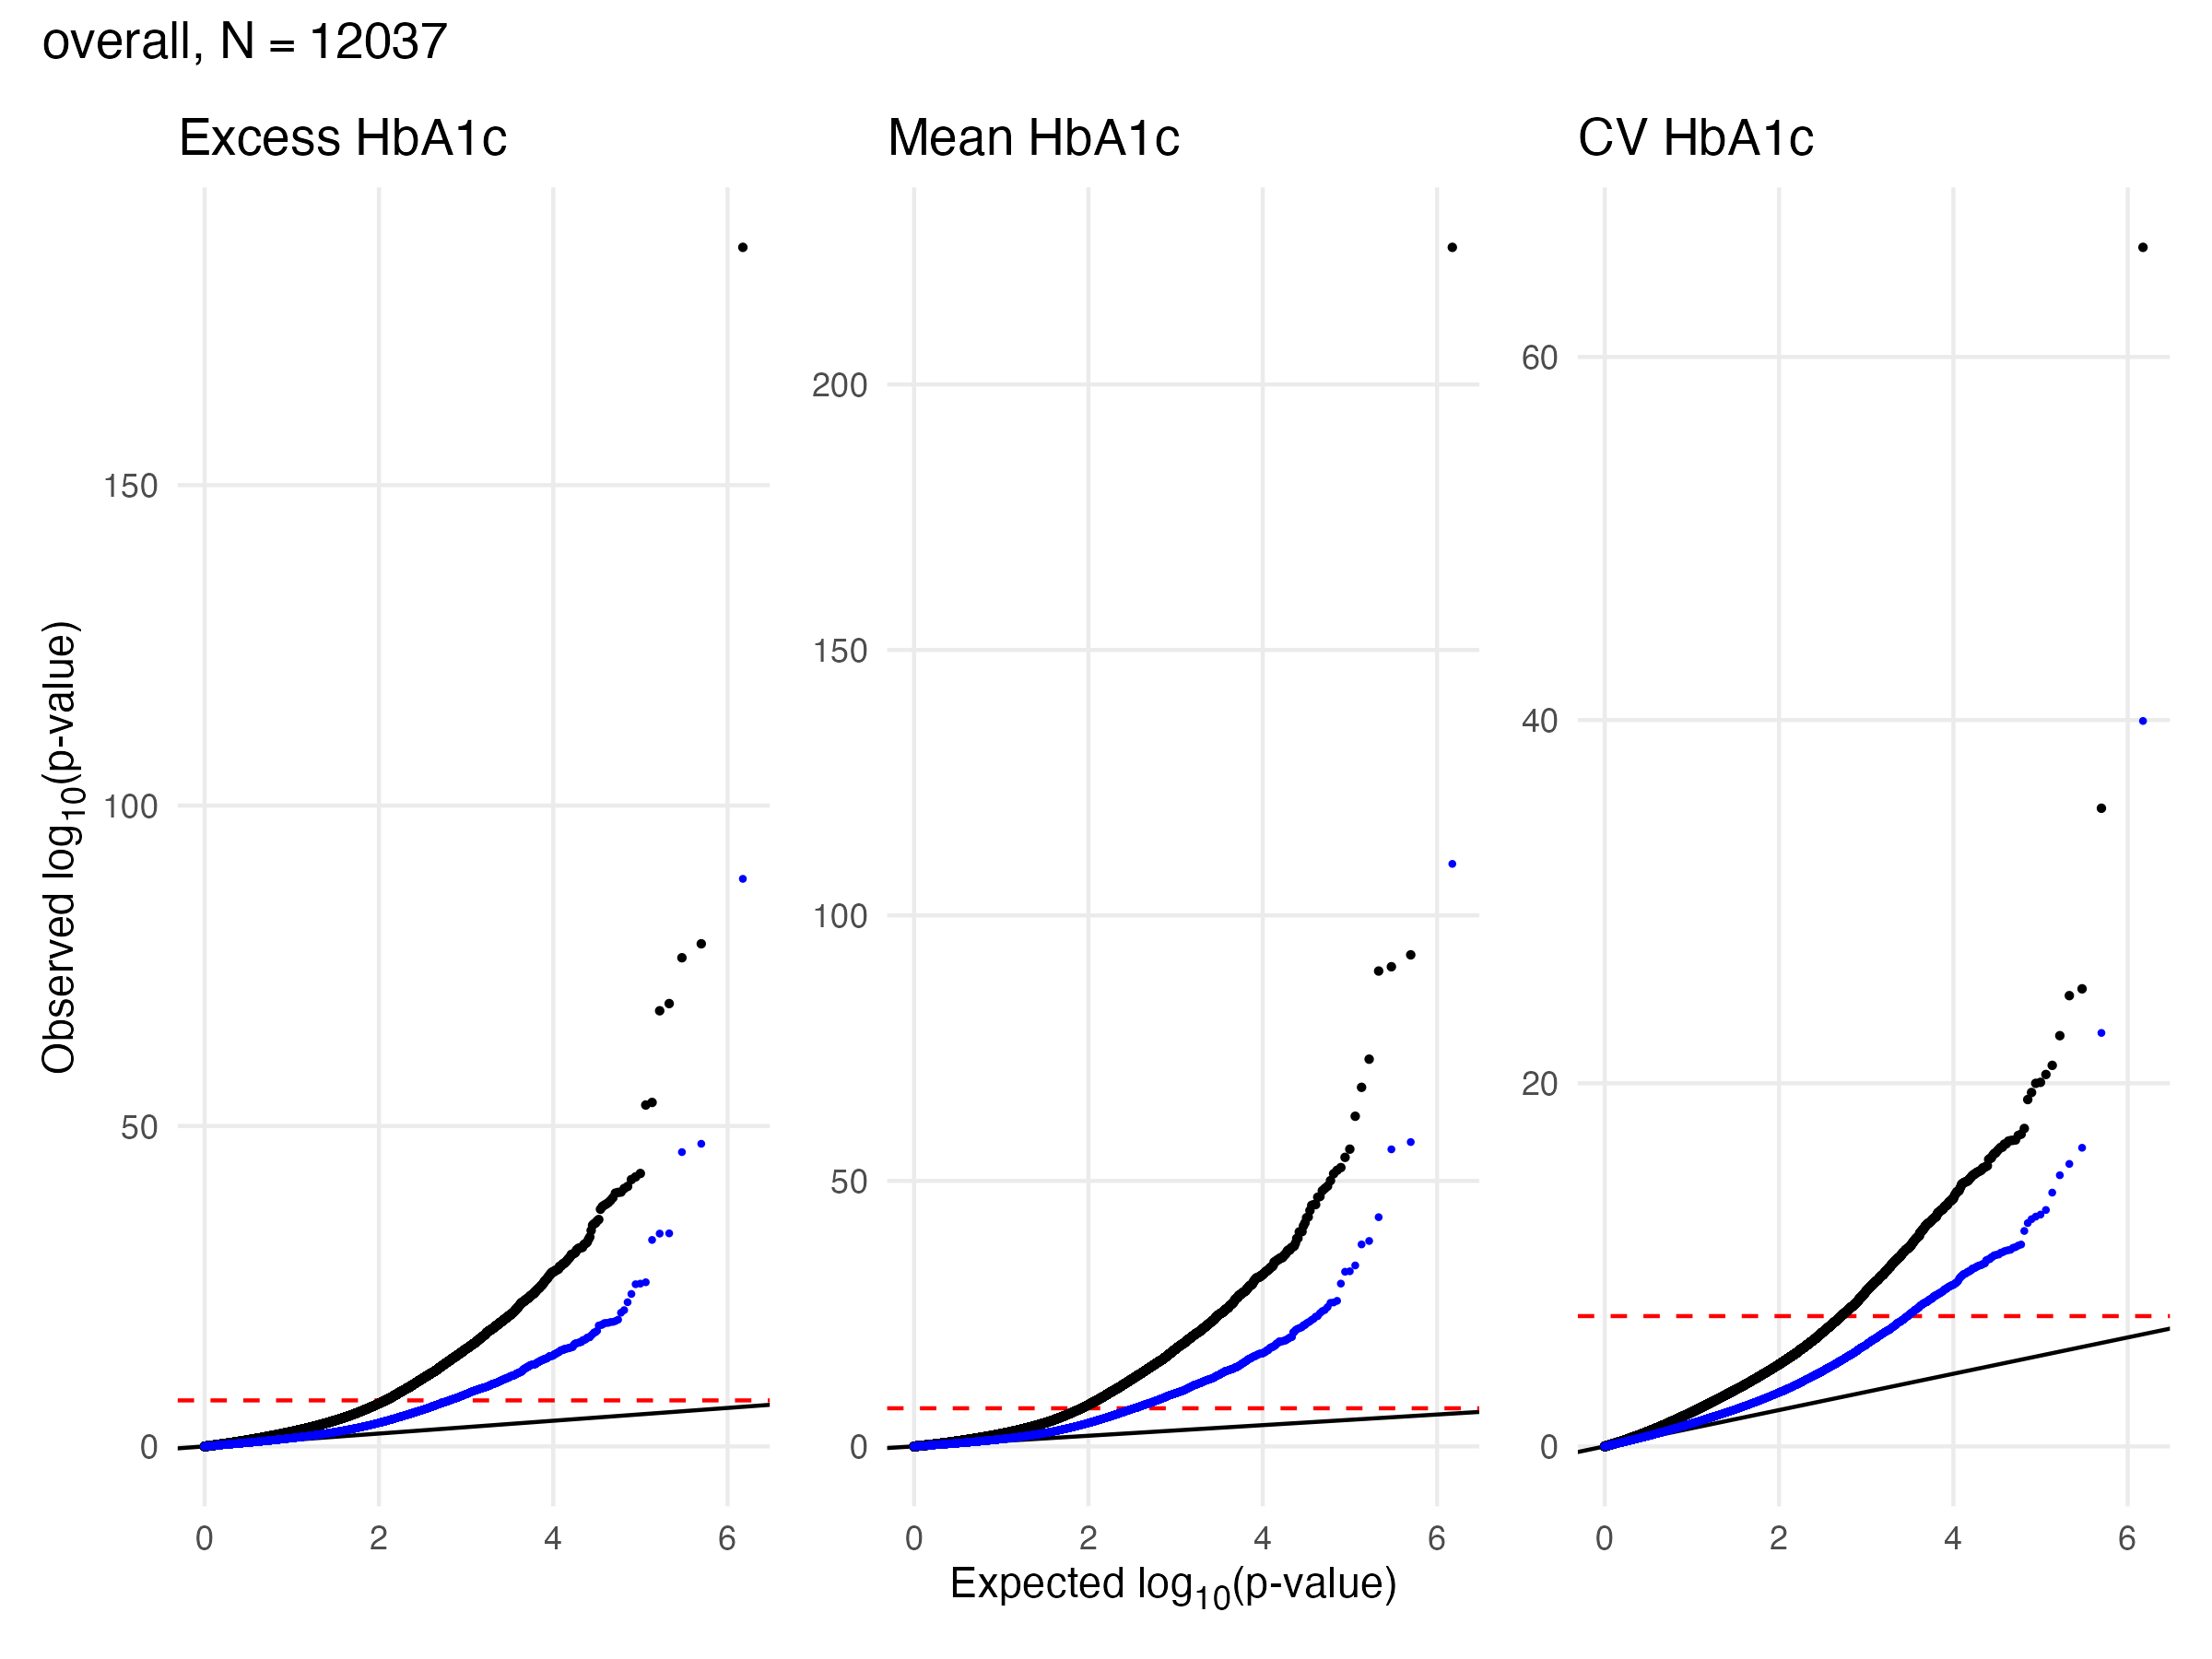
EWAS Results - A1c - Overall
Overall Sample EWAS QQ Plot

Slide 12
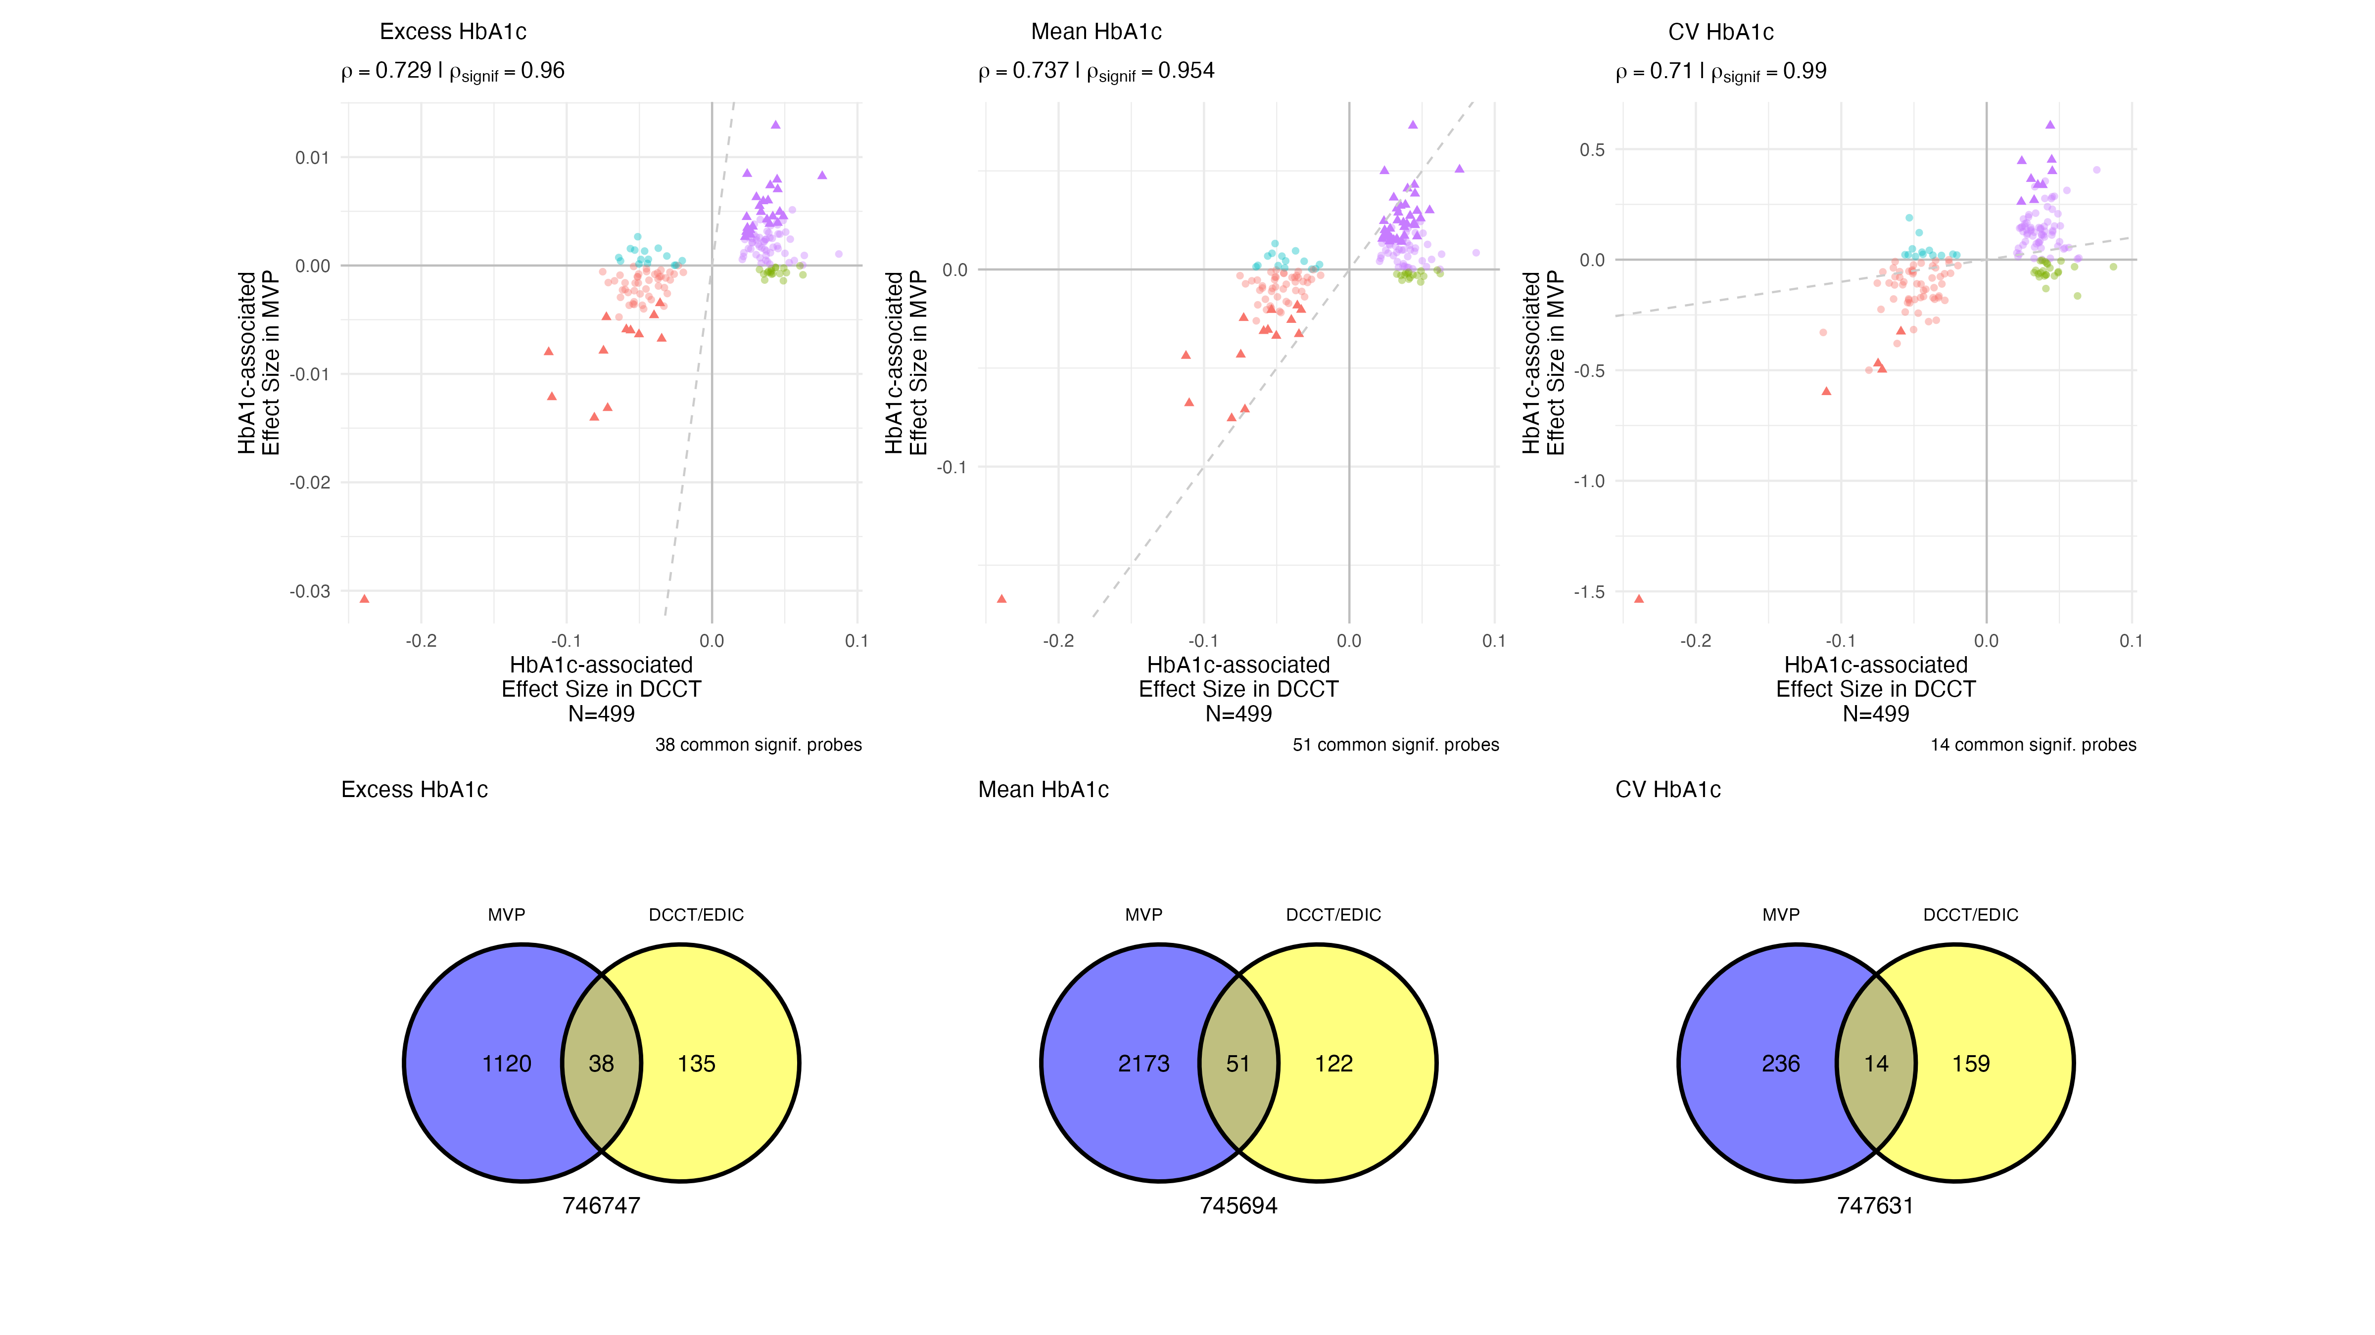
EWAS Validation - A1c - Overall
Comparisons to Chen 2020

Slide 13
EWAS Results - A1c - Annotation
Exposure | Signif. CpGs | Gene Count
Excess | 1158 | 35
Mean | 2224 | 63
CV | 250 | 8
Any Exposure | 2303 | 74
All Exposures | 159 | 3
GREAT(McLean et al. 2010) was used to identify genes significantly enriched in glycemia associated CpG sites for each exposure at FDR < 0.05

Slide 14
EWAS Results - A1c - Annotation
Gene | Chr | Name | Found in Chen 2020
TXNIP | 1 | thioredoxin interacting protein (Miller et al. 2023; Tsai et al. 2022; Chen et al. 2016) | Y
BRD7 | 16 | bromodomain containing 7 | N
ADCY7 | 16 | adenylate cyclase 7 | Y

Slide 15
TXNIP, BRD7, and ADCY7 were the only genes enriched in CpG sites associated with all three glycemic exposures
BRD7 is a regulatory gene, that acts as an activator and binds to the ESR1 promoter, and is related to histone acetylation and chromativn structure regulation
ADCY7 is involved in cAMP production, a cellular signaler, and mediates glucagon and incretin hormone responses that regulate blood glucose, insulin secretion, and hepatic glucose production.
TXNIP glucose-sensitive regulator of pancreas function, hypomethylation at TXNIP is strongly associated with glycemic exposure

Slide 16
Functional Annotation

Slide 17
EWAS Functional Annotation - Excess HbA1c

Slide 18
EWAS Functional Annotation - Mean HbA1c

Slide 19
EWAS Functional Annotation - CV HbA1c

Slide 20
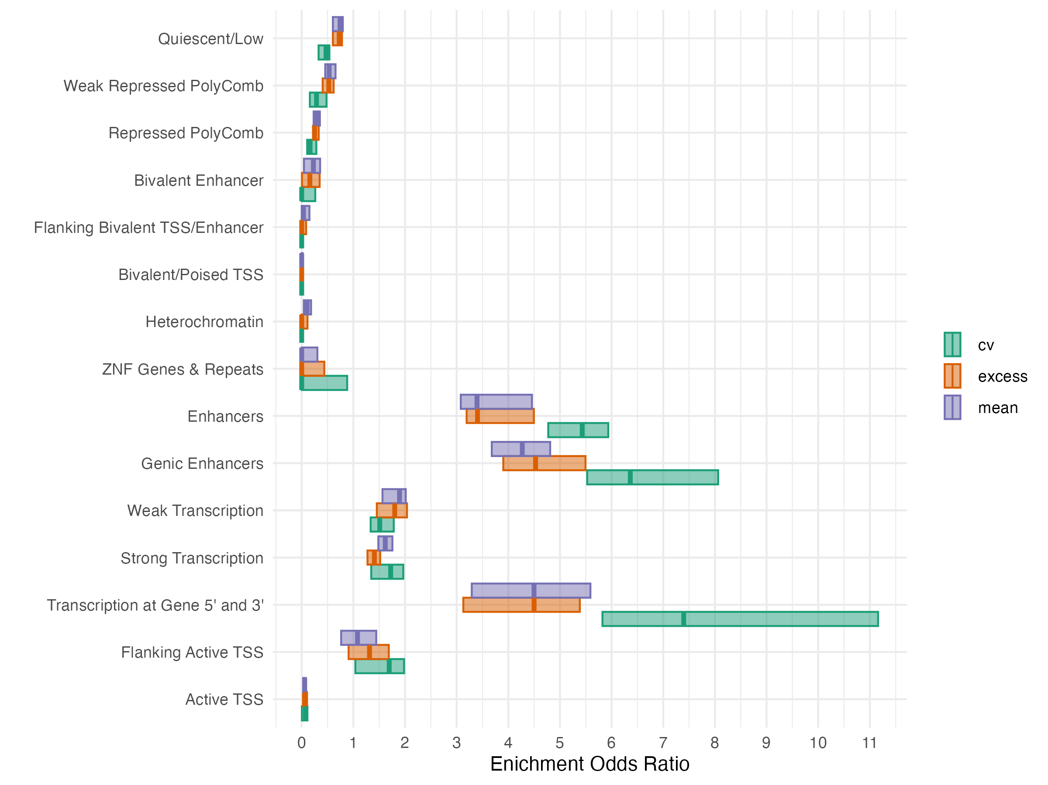
EWAS Functional Annotation - Chromatin State
Chromatin State Enrichment in Blood Samples at Glycemia Associated CpGs

Slide 21
Mediation Model

Slide 22
Outcome Model
$$\begin{matrix}\text{Time to Diabetic Retinopathy} & ∼\text{Exposure + DNA Methylation + sex + age + BMI} \\ & +\text{Systolic Blood Pressure} \\ & +\text{Diastolic Blood Pressure} \\ & +\text{Blood Lipids} \\ & +\text{ Time since Diabetes Dx (years)}\end{matrix}$$
Time to retinopathy was modeled by an Weibull accelerated failure time model
Baseline BMI, blood pressure, and blood lipids (Total Cholesterol, HDL-C, Triglycerides) were defined as the nearest measurement to MVP blood sample collection, up to six months post blood-sample collection
  Subjects missing any baseline biomarkers were excluded
Subjects with any prior history of diabetic retinopathy were excluded

Slide 23
Causal Mediation Model

Slide 24
Causal Mediation
Exposure: $A$, Glycemic Exposure
Mediator(s): $M$, CpG site methylation
Outcome: $T$, Time-to-Retinopathy following MVP sample collection
$$\begin{matrix}M & =β_{0}+β_{1}A+β_{2}^{⊤}z+ξ \\ log\left(T\right) & =θ_{0}+θ_{1}A+θ_{2}M+θ_{3}^{⊤}z+σϵ\end{matrix}$$
Causal Estimands
$$\begin{matrix}\text{Natural Direct Effect} & :NDE\left(a, a^{*}\right)=θ_{1}\left(a−a^{*}\right) \\ \text{Natural Indirect Effect} & :NIE\left(a, a^{*}\right)=θ_{2}β_{1}\left(a−a^{*}\right)\end{matrix}$$
- We assume a symmetric one standard deviation difference about the sample mean for each exposure

Slide 25
Composite Null Hypothesis:
$$\begin{matrix}H_{01} & :β_{1}=0∧θ_{3}≠0 \\ H_{10} & :β_{1}≠0∧θ_{3}=0 \\ H_{01} & :β_{1}=0∧θ_{3}=0 \\ \end{matrix}$$
Significance testing performed using HDMT R package (Dai, Stanford, and LeBlanc 2022)
Mediation P-value given by the maximum of the p-values associated with testing $β_{1}=0$ and $θ_{2}=0$
Max-P statistic: $p_{max}=max\{Pr\left[β_{1}=0\right], Pr\left[θ_{2}=0\right]\}$
$p_{max}$ is not uniformly distributed under the null, HDMT procedure estimates the proportion of each type of null $π_{01},π_{10},π_{00}$ to control family-wise error and false discovery rate

Slide 26
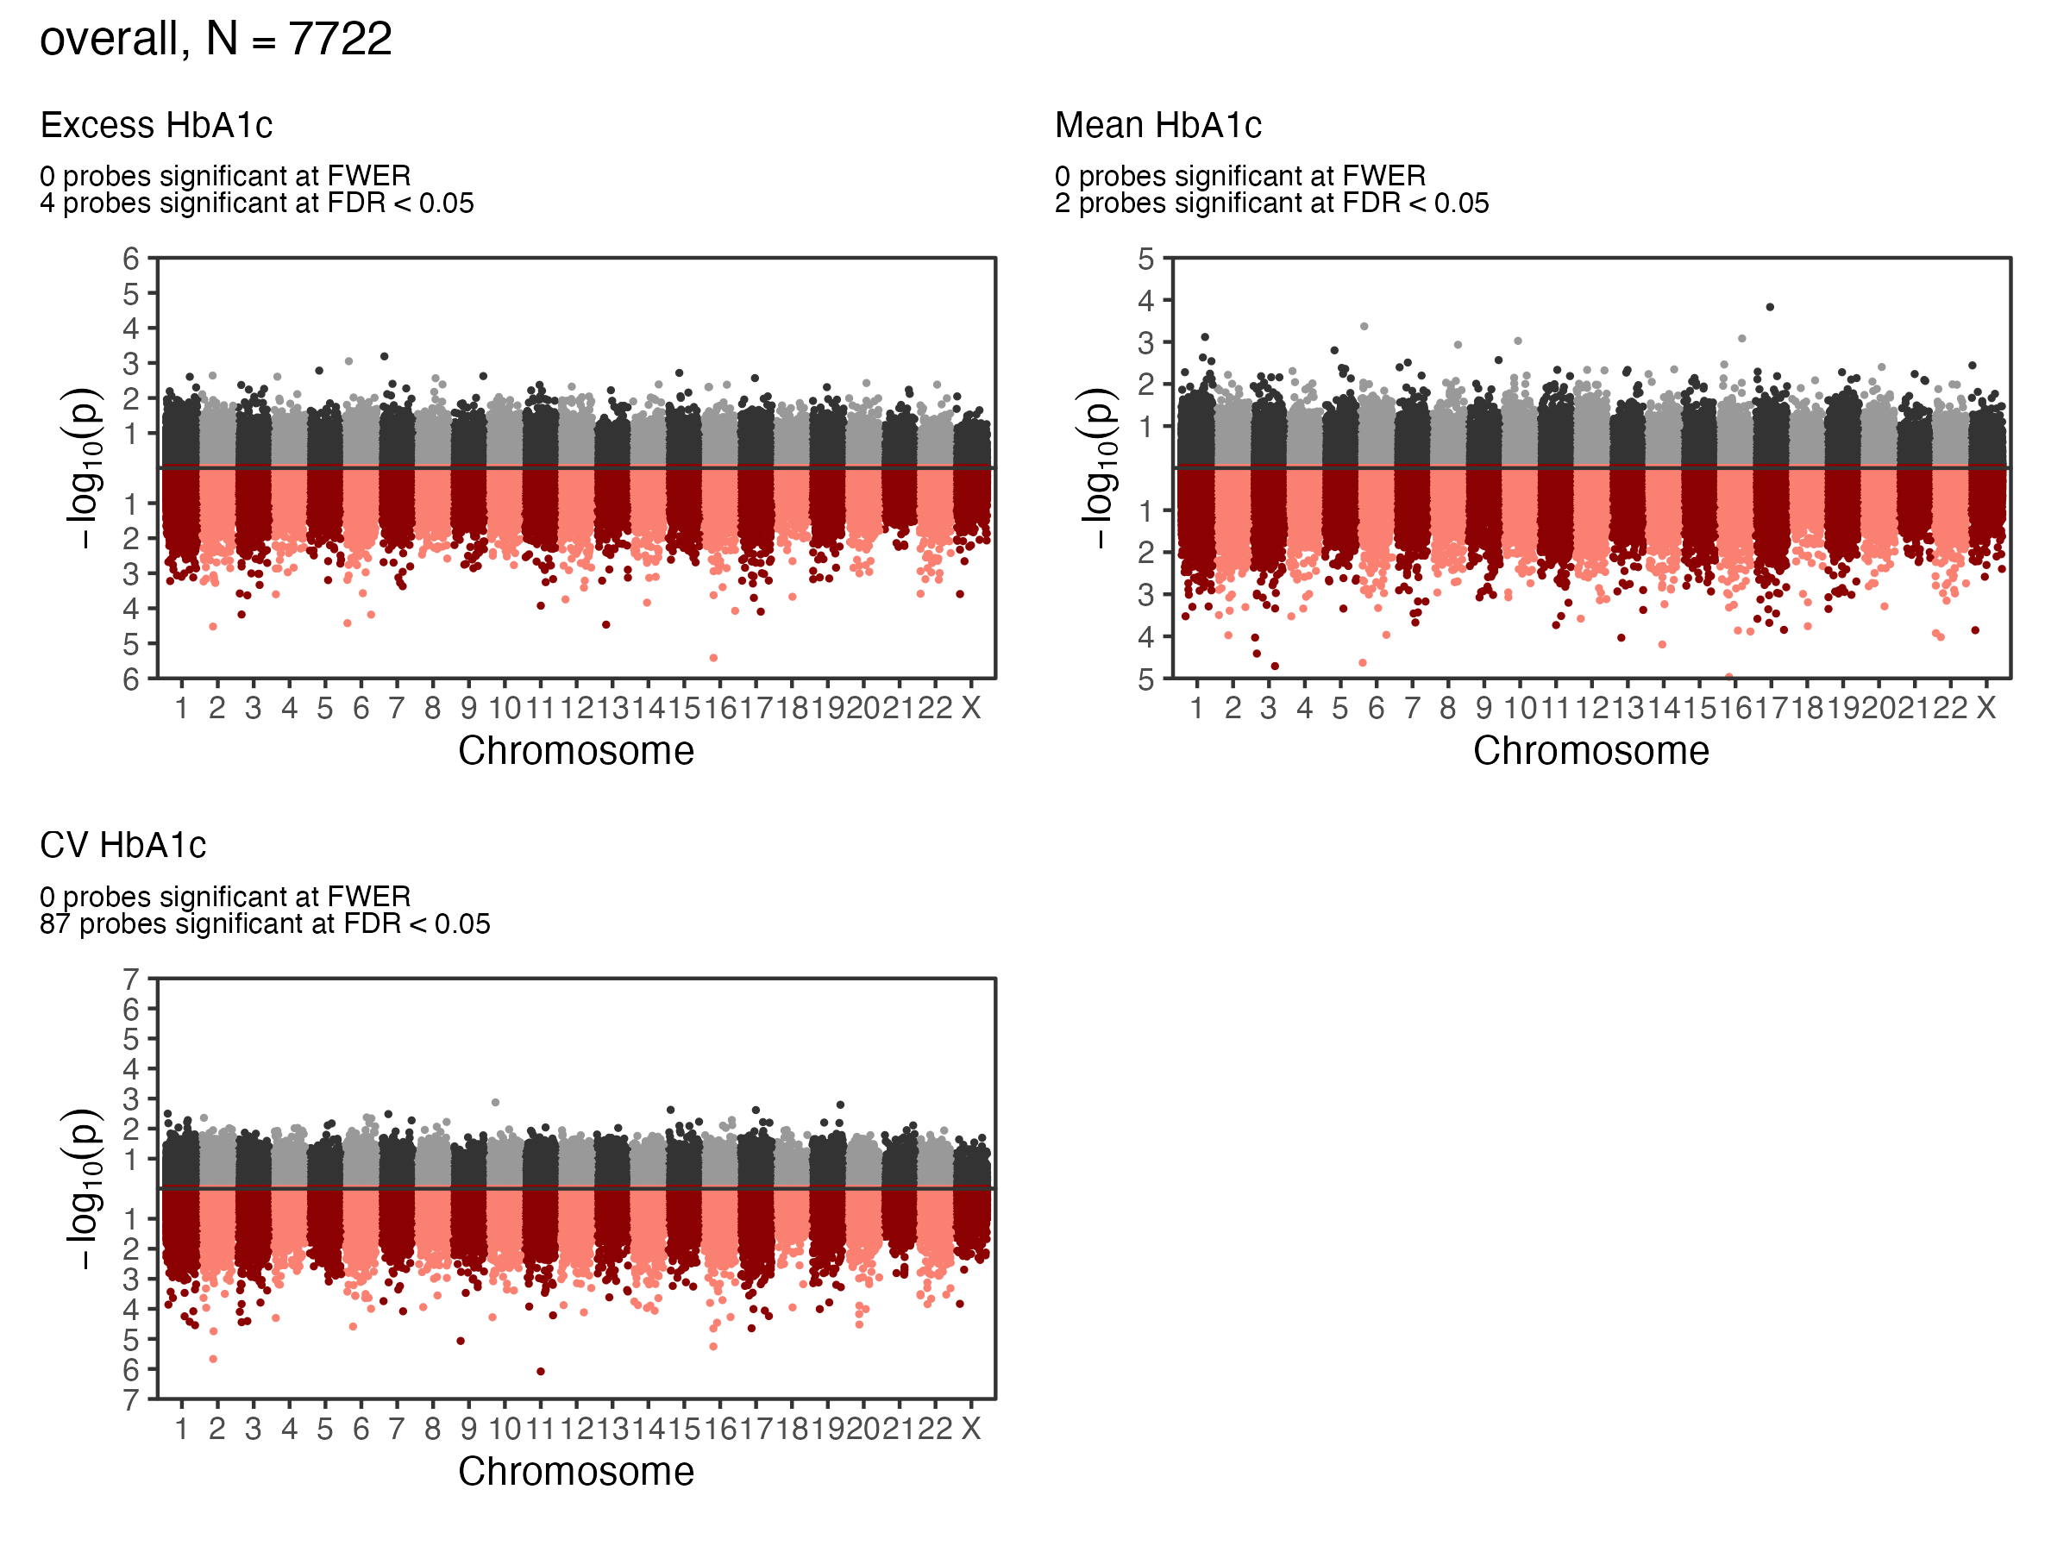
Causal Mediation - Indirect Effects
Figure 2: Indirect Effect Manhattan Plot, Max-P

Slide 27
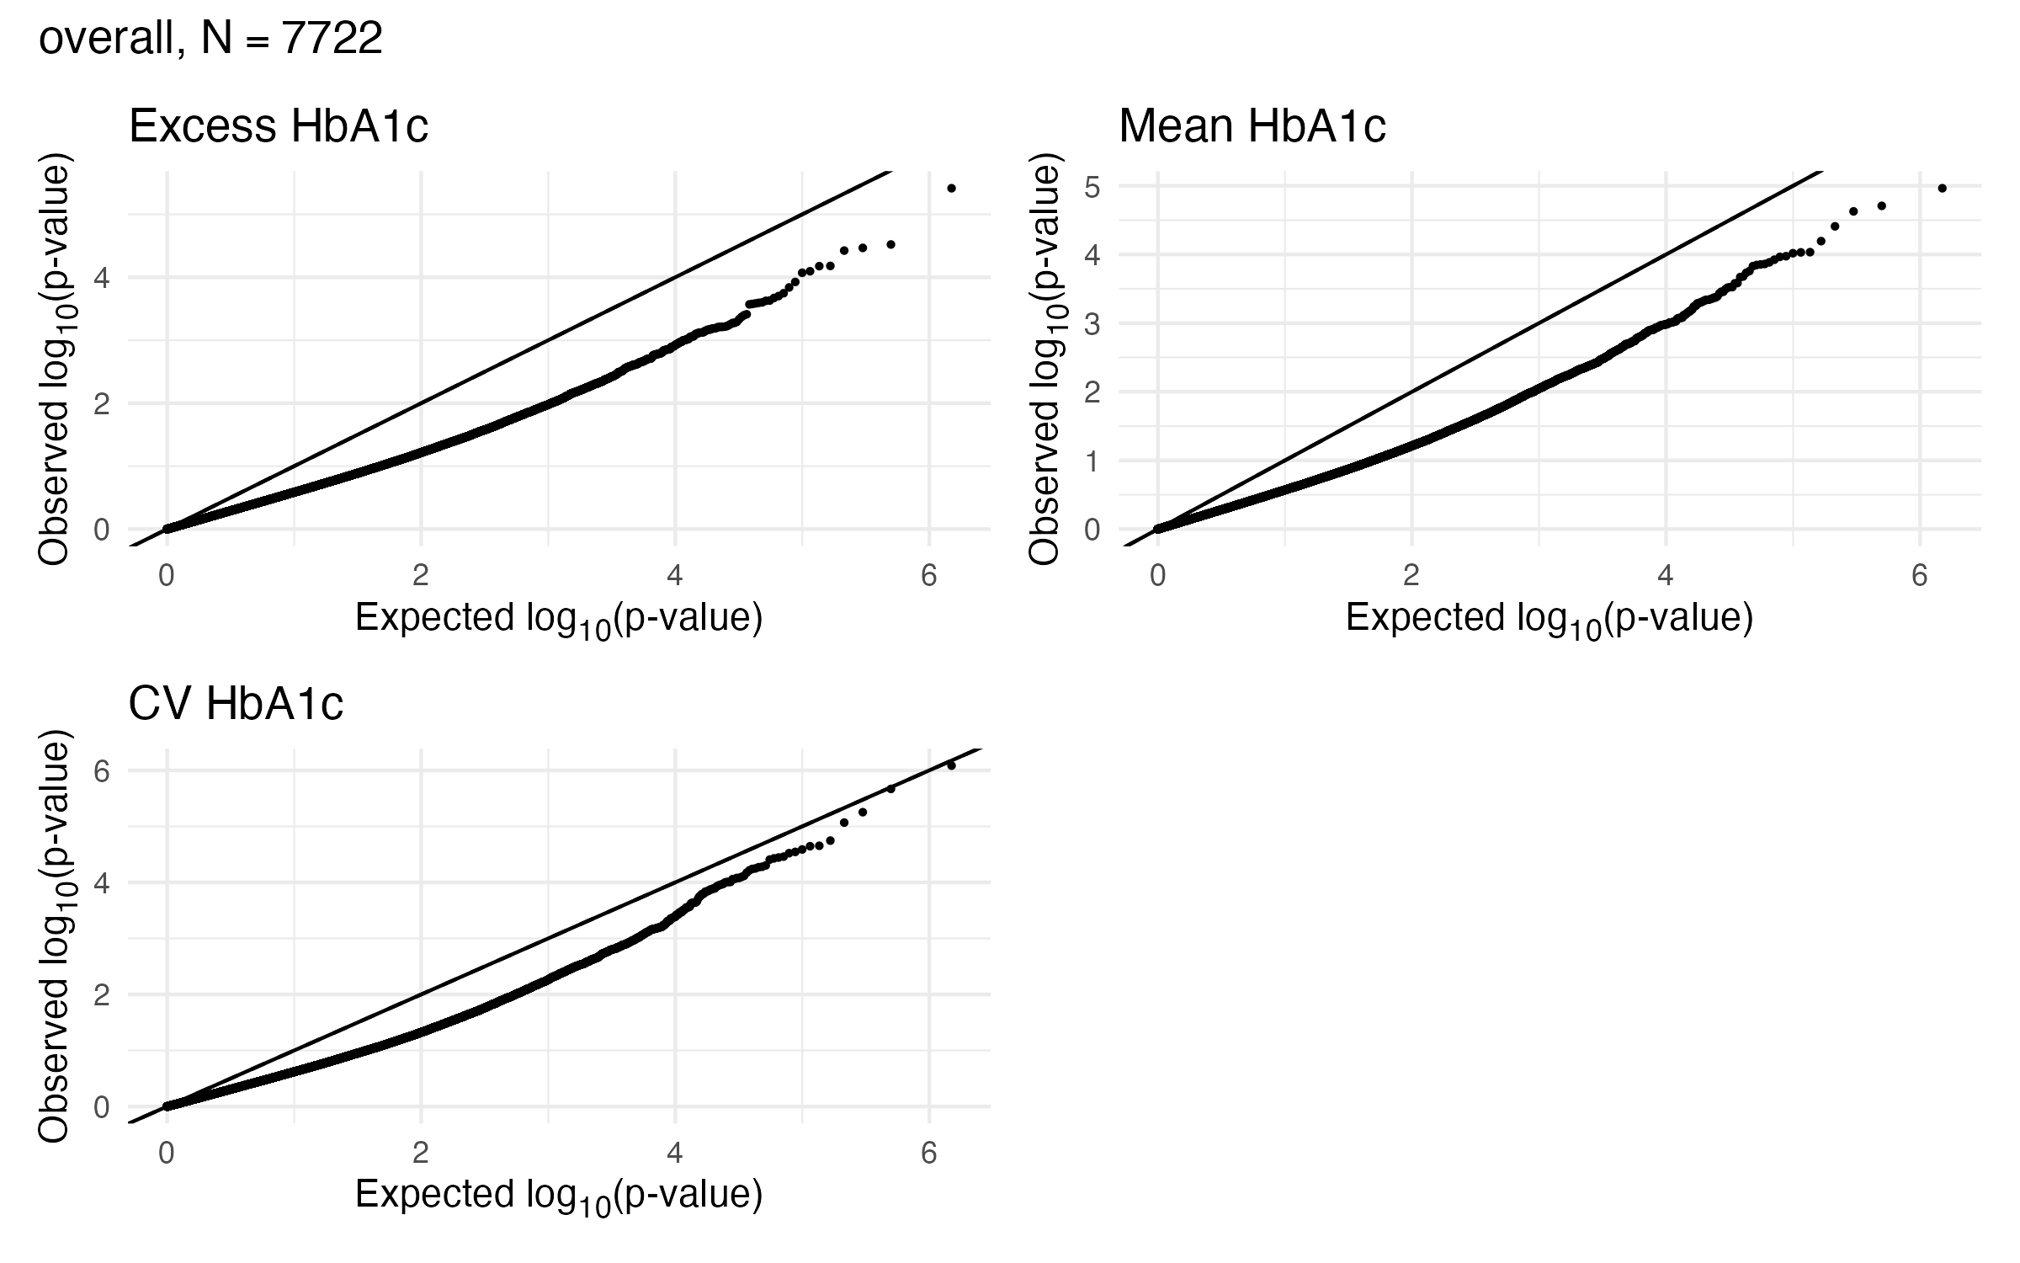
Causal Mediation - Indirect Effects
Figure 3: Indirect Effect QQ Plot, Max-P

Slide 28
Max-P statistic is severely underdispersed relative to a uniform null distribution

Slide 29
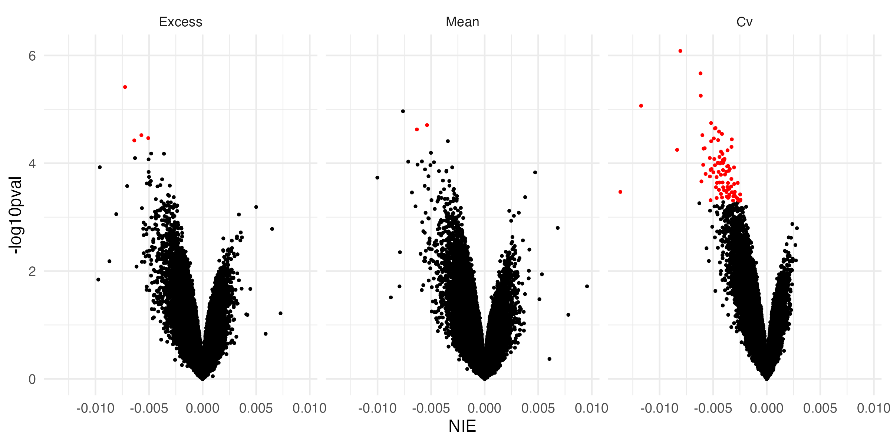
Causal Mediation - Volcano Plot
Figure 4: Indirect Effect versus Negative $\log_{10}\left(p_{max}\right)$, red indicates signficant mediators at FDR < 0.05

Slide 30
At all significant mediators, increased glycemic exposure is associated with a decrease in time-to-retinopathy

Slide 31
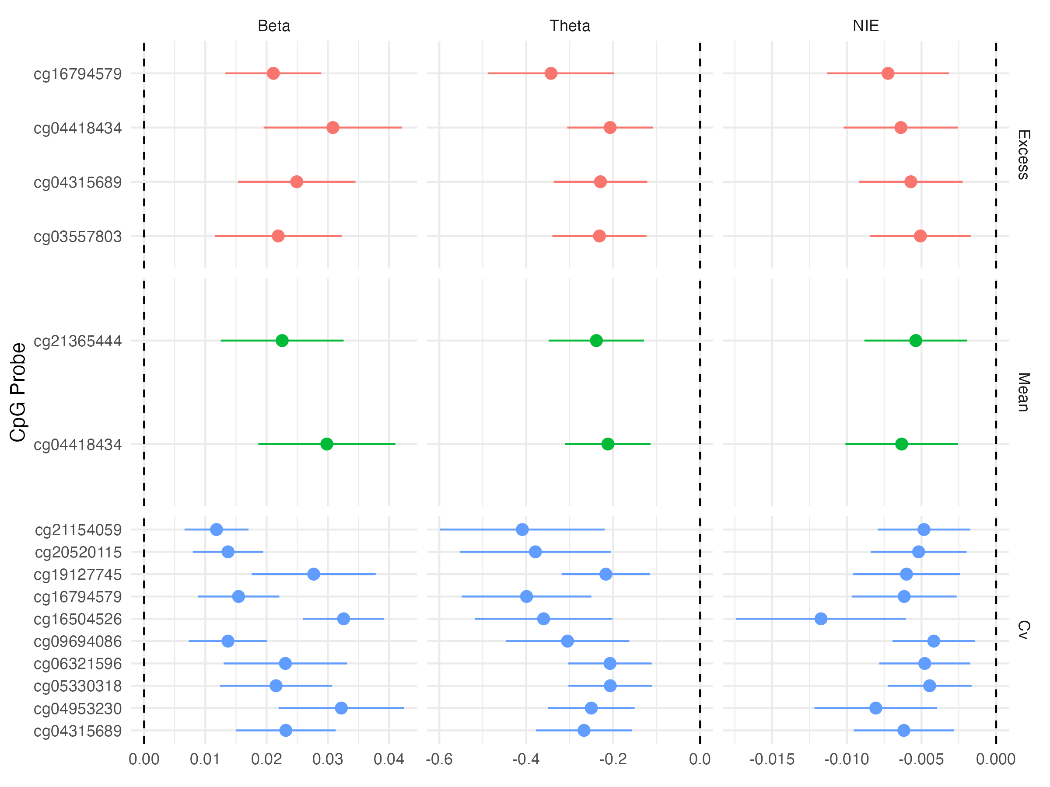
Causal Mediation - Indirect Effects
Figure 5: Indirect Effect Plot, Top 10 Marginally Significant Mediators

Slide 32
Expected changes in methylation given changes in glycemic exposure appear to be relatively small
Individual CpG sites do not capture much of a mediation effect of glycemia on time-to-retinopathy
Mean and excess HbA1c effect on retinopathy onset is marginally mediated by methylation at two and four CpG sites, respectively
  Mean and excess HbA1c are associated withcg04418434 is hypermethylated in the 5’UTR region of RREB1
  cg04418434 is hypermethylated in the 5’UTR region of RREB1
CV HbA1c’s effect on DR onset is mediated at 87 CpG sites

Slide 33
Causal Mediation Annotation
Gene | Name | CHR | Mean | Excess | CV | Gene Region
ARF1 | ADP Ribosylation Factor 1 | 1 |  |  | X | 5’UTR
MALAT1 | Metastasis Associated Lung Adenocarcinoma Transcript 1 | 11 |  |  | X | Body
ELF1 | E74 Like ETS Transcription Factor 1 | 13 |  | X |  | 5’UTR
XYLT1 | Xylosyltransferase 1 | 16 | X |  | X | Body
HK2 | Hexokinase 2 | 2 |  |  | X | Body
DGUOK-AS1 | DGUOK Antisense RNA 1 | 2 |  | X | X | Body
RREB1 | Ras Responsive Element Binding Protein 1 | 6 | X | X |  | 5’UTR
KLF9 | KLF Transcription Factor 9 | 9 |  |  | X | Body
Top genes with CpG sites that mediate glycemic exposure on time to retinopathy

Slide 34
ARF1, MALAT1, ELF1, RREB1, KLF9 all have either been found to be expressed in retinal tissue or have also been shown to be associated with retinal disease or macular degeneration
XYLT1 has been previously been associated with age-related macular degeneration
DGUOK-AS1 has been previously been found to be associated with several cancers, but association with retinopathy appears to be novel

Slide 35
Further Work
Mediation analysis of time to renal disease onset in T2D is ongoing
Joint mediation analysis to be performed considering all marginally significant mediators together, to capture the overall mediaiton effect
Mediation analysis of DR progression: 16-17% of T2D patients with retinopathy in MVP prior to blood sample collection later develop diabetic macular edema, an advanced complication of retinopathy
Breeyear, Joseph H, Sabrina L Mitchell, Cari L Nealon, Jacklyn N Hellwege, Brian Charest, Anjali Khakaria, Christopher W Halladay, et al. 2023. “Development of Portable Electronic Health Record Based Algorithms to Identify Individuals with Diabetic Retinopathy.” medRxiv, 2023–11.
Chen, Zhuo, Feng Miao, Andrew D Paterson, John M Lachin, Lingxiao Zhang, Dustin E Schones, Xiwei Wu, et al. 2016. “Epigenomic Profiling Reveals an Association Between Persistence of DNA Methylation and Metabolic Memory in the DCCT/EDIC Type 1 Diabetes Cohort.” Proceedings of the National Academy of Sciences 113 (21): E3002–11.
Dai, James Y, Janet L Stanford, and Michael LeBlanc. 2022. “A Multiple-Testing Procedure for High-Dimensional Mediation Hypotheses.” Journal of the American Statistical Association 117 (537): 198–213.
McLean, Cory Y, Dave Bristor, Michael Hiller, Shoa L Clarke, Bruce T Schaar, Craig B Lowe, Aaron M Wenger, and Gill Bejerano. 2010. “GREAT Improves Functional Interpretation of Cis-Regulatory Regions.” Nature Biotechnology 28 (5): 495–501.
Miller, Rachel G, Josyf C Mychaleckyj, Suna Onengut-Gumuscu, Trevor J Orchard, and Tina Costacou. 2023. “TXNIP DNA Methylation Is Associated with Glycemic Control over 28 Years in Type 1 Diabetes: Findings from the Pittsburgh Epidemiology of Diabetes Complications (EDC) Study.” BMJ Open Diabetes Research and Care 11 (1): e003068.
Tsai, Hao-Hung, Chao-Yu Shen, Chien-Chang Ho, Shu-Yi Hsu, Disline Manli Tantoh, Oswald Ndi Nfor, Shin-Lin Chiu, Ying-Hsiang Chou, and Yung-Po Liaw. 2022. “Interaction Between a Diabetes-Related Methylation Site (TXNIP Cg19693031) and Variant (GLUT1 Rs841853) on Fasting Blood Glucose Levels Among Non-Diabetics.” Journal of Translational Medicine 20 (1): 87.
Yang, Peter K, Sandra L Jackson, Brian R Charest, Yiling J Cheng, Yan V Sun, Sridharan Raghavan, Elizabeth M Litkowski, et al. 2024. “Type 1 Diabetes Genetic Risk in 109,954 Veterans with Adult-Onset Diabetes: The Million Veteran Program (MVP).” Diabetes Care 47 (6): 1032–41.

Slide 36
Notes
1. interval between the date of the first DM diagnosis code to MVP sample collection date

